Slide 1

Project Quack
Presented by
The Bestagons
Notes:
Miles

Slide 2
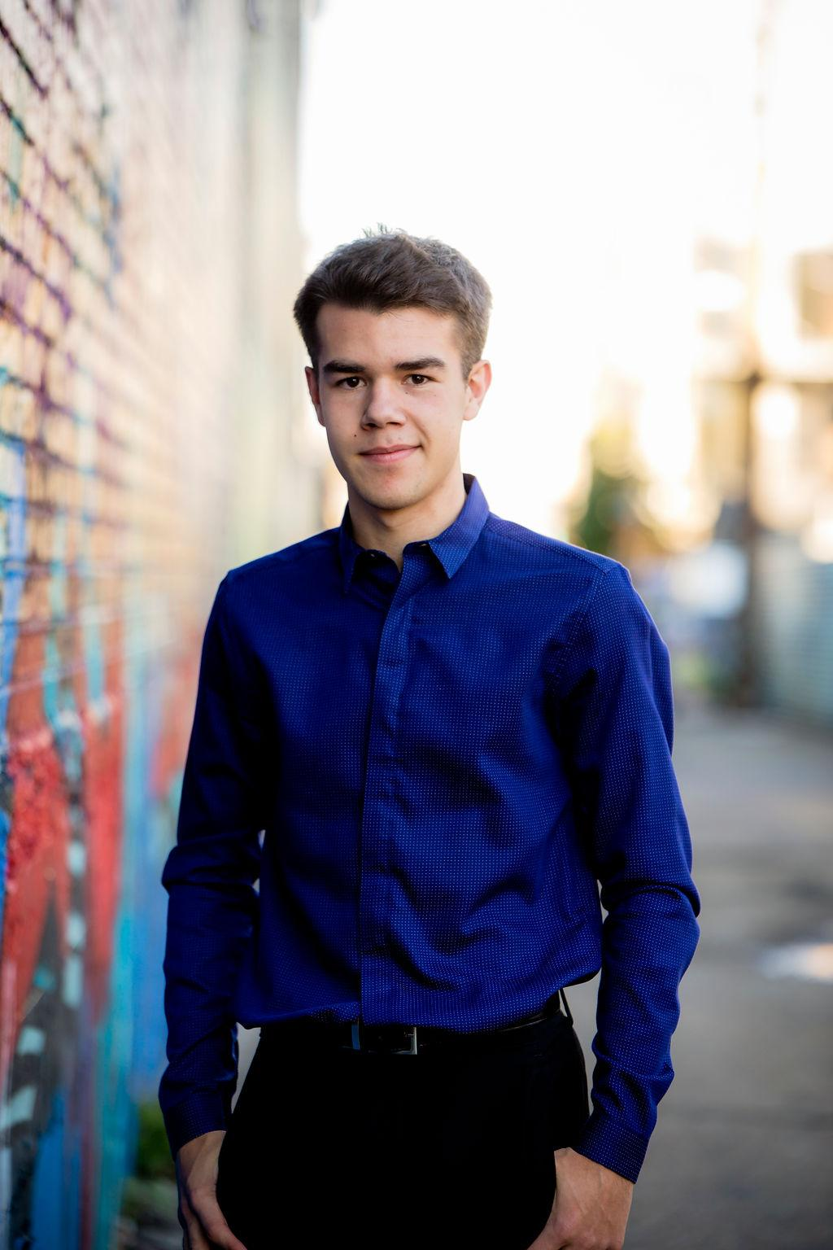


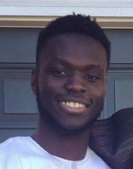
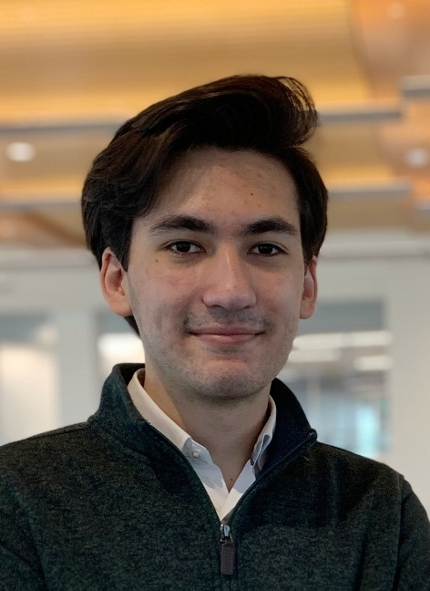
OUR TEAM
Ore Adenikinju
Miles Robertson
Rafael Piloto
Team member
Product Owner
Scrum Master
Notes:
delete?

Slide 3
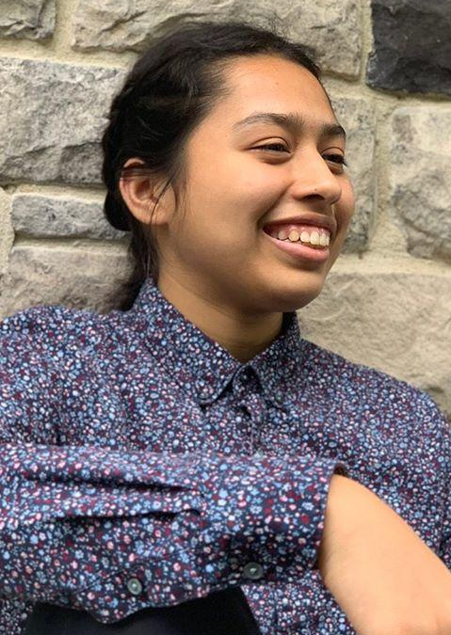
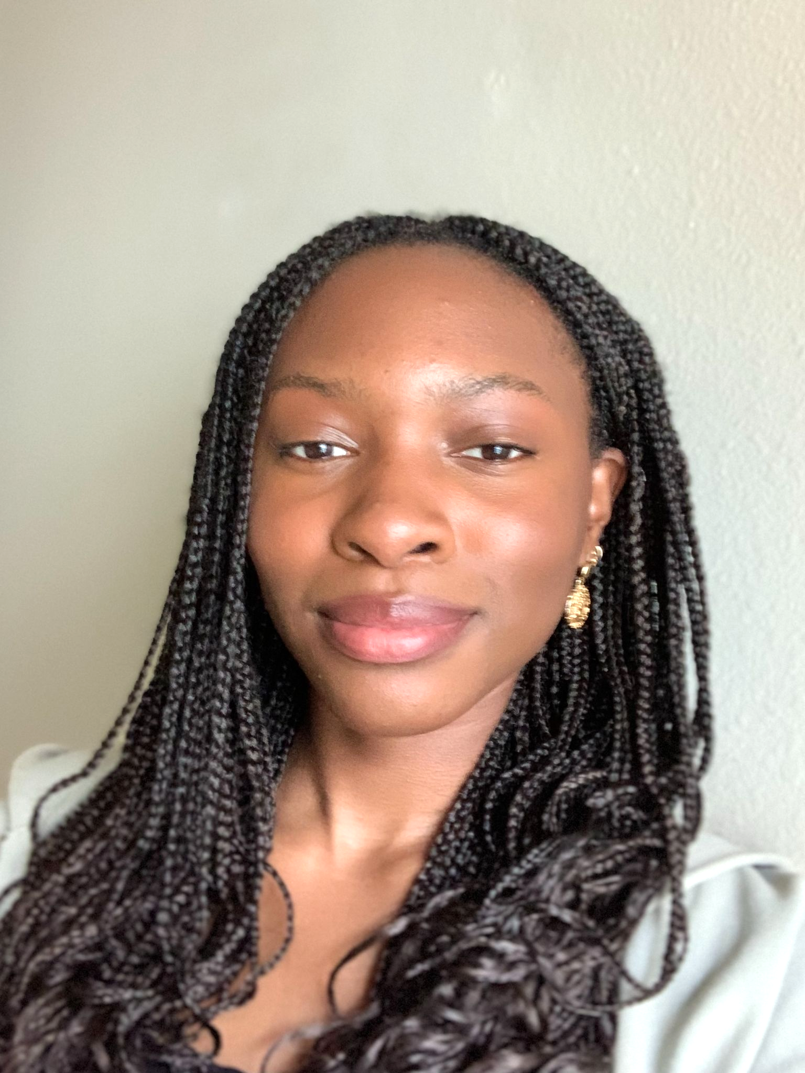
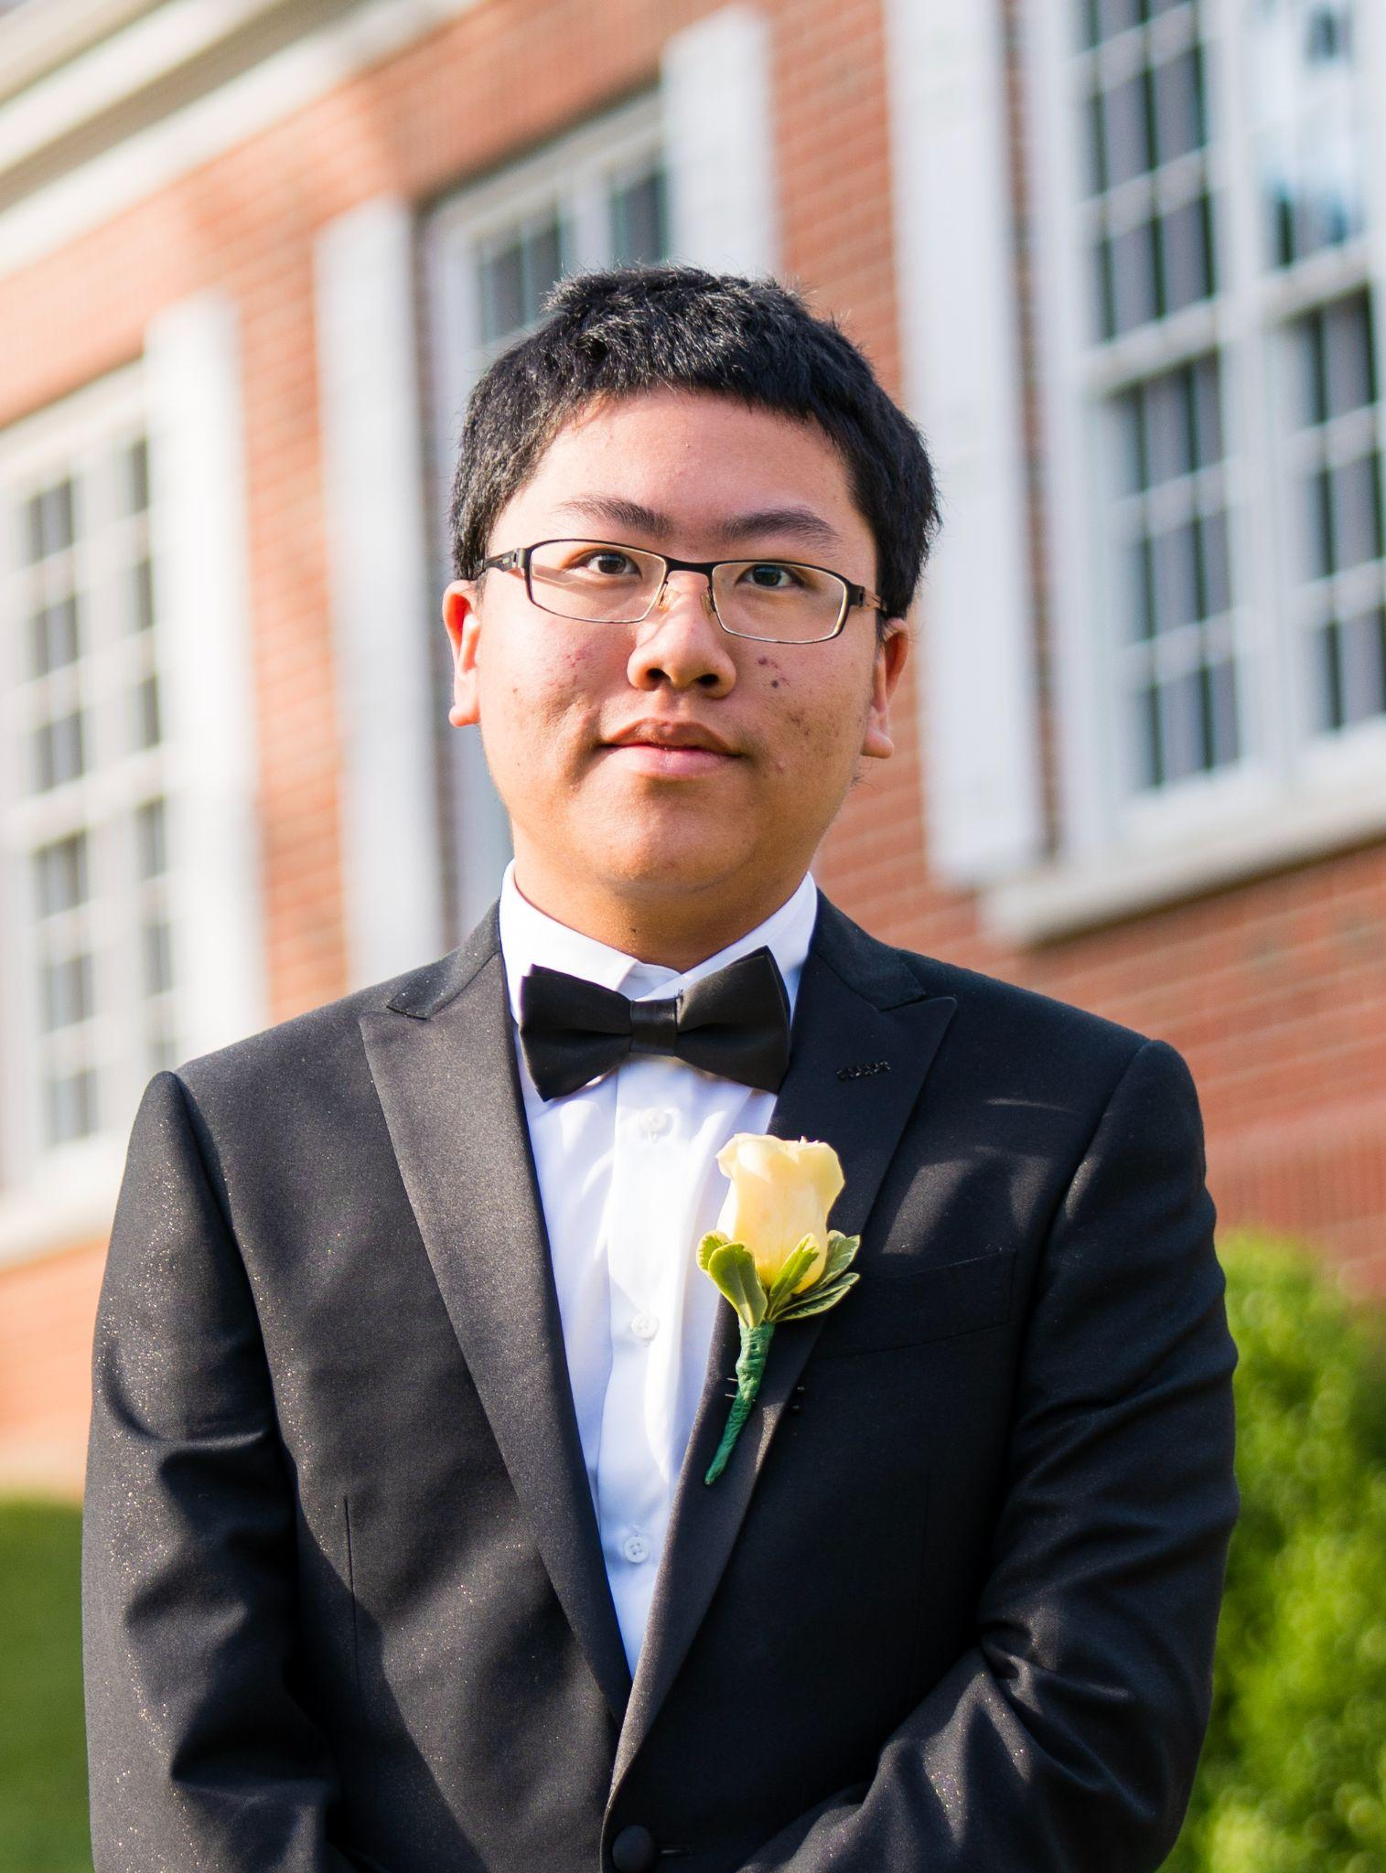
OUR TEAM
Mimi Olayeye
Brenda Cano
David Wei
Team Member
Team Member
Team member
Notes:
delete?

Slide 4
AGENDA
01
03
02
Acknowledging Feedback
What are our goals for the week?
What did we accomplish?
Notes:
Miles

Slide 5
01
Acknowledging Feedback
Notes:
Mimi

Slide 6
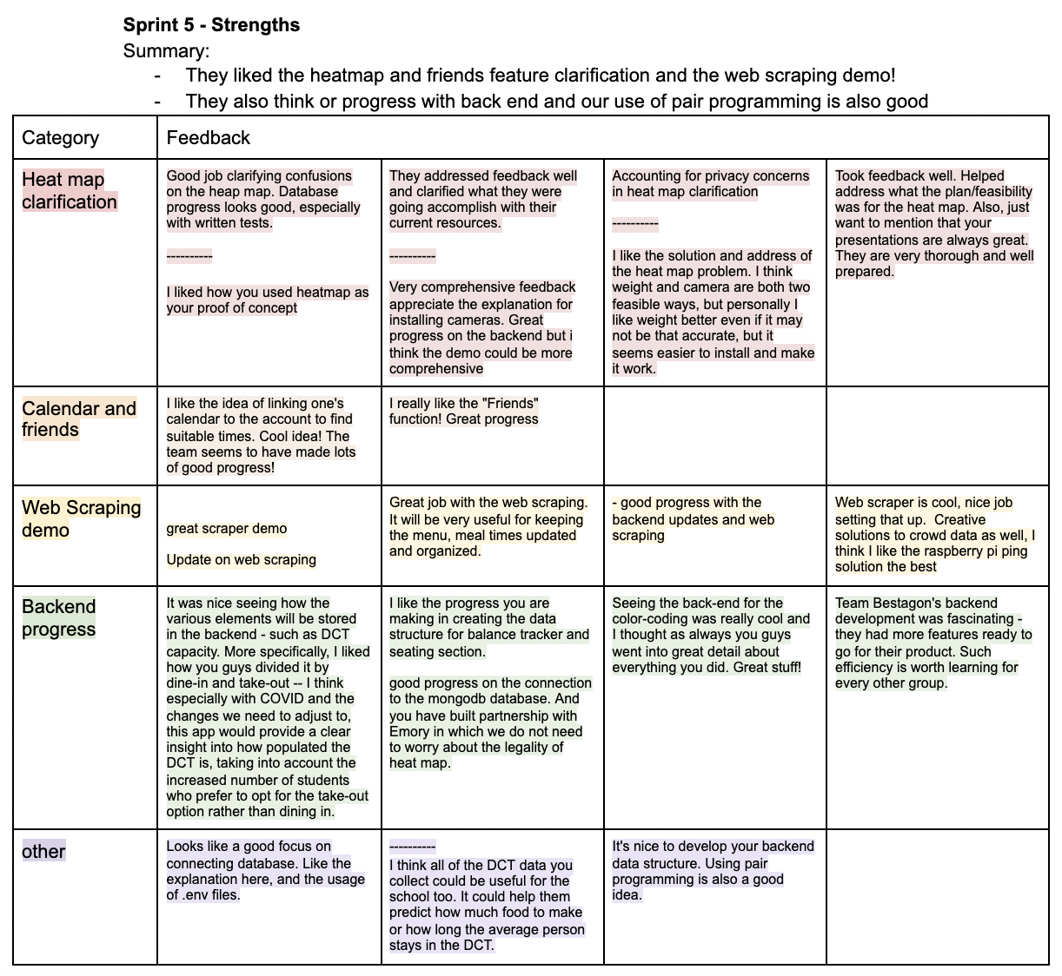
Strengths
Notes:
Mimi

Slide 7
Reducing our scope because heatmap is too lofty of a goal
Working API
Suggestions
We meet weekly to talk about our project
If we find that anything in our project is too much to handle then we will act accordingly
Accuracy
More Demos
Showing App design
Connecting Front End to Back End (sprint 7)
Notes:
Mimi

Slide 8
02
What did we accomplish?
Notes:
Rafael

Slide 9
App Demo!
Notes:
Rafael

Slide 10
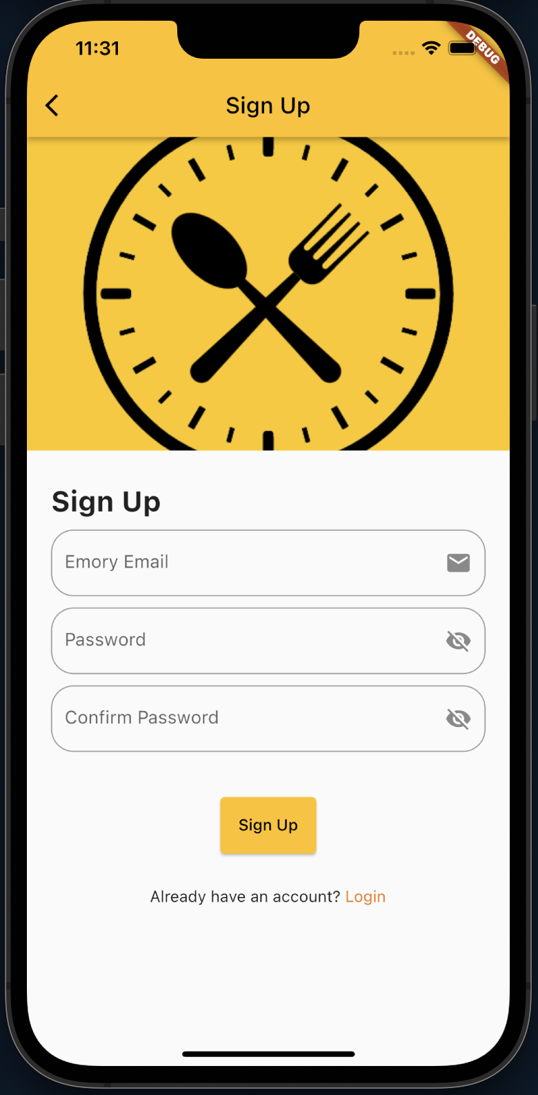
Frontend:
Sign Up Page
Skeleton for email verification in place once implemented in backend
Form validation
Notes:
rafael

Slide 11
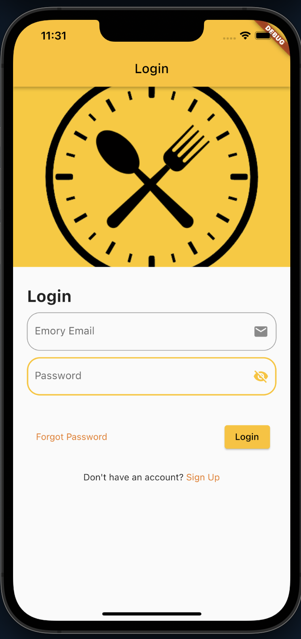
Frontend:
Login Page
Auto-login with cached credentials
Form validation
Forgot Password not implemented yet
Notes:
rafael

Slide 12
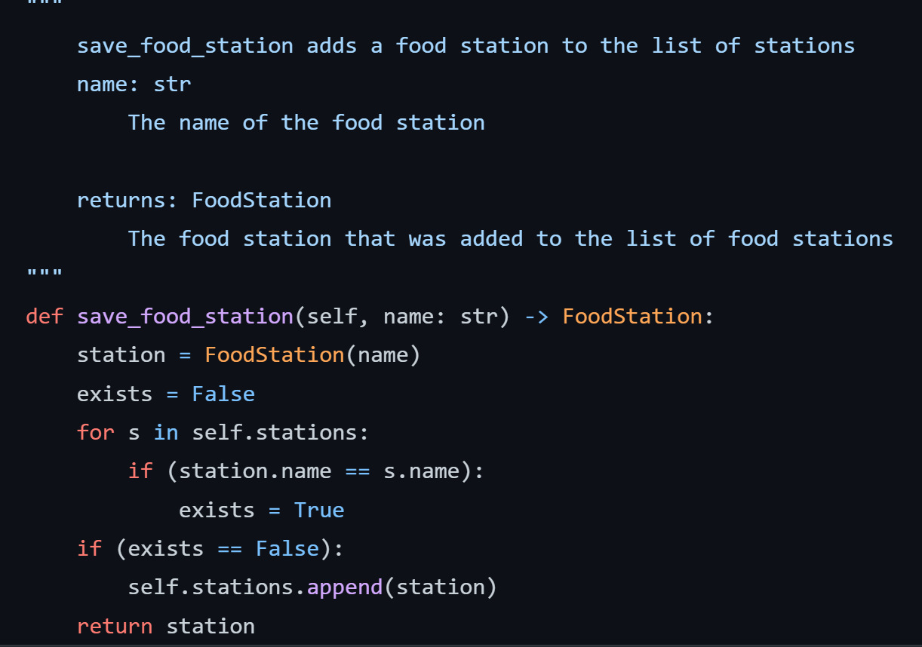
Save DCT Food Stations in DCT Backend
Notes:
Brenda Save food stations
Worked on improving the food stations mentioned last sprint. So when the food stations are webscraped we can use this helper method to save the stations in a preexisting list of station names and it checks if the food station already exists. It is done in this way so that if emory changes its food stations in the future

Slide 13
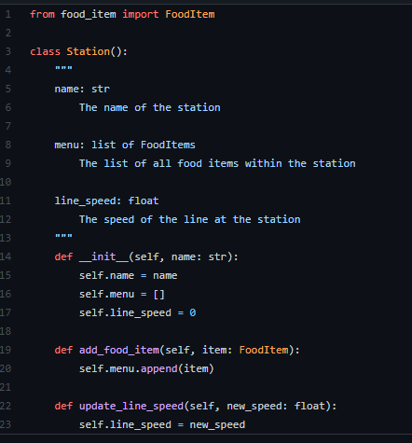
Food Station Object
Notes:
Ore

Slide 14
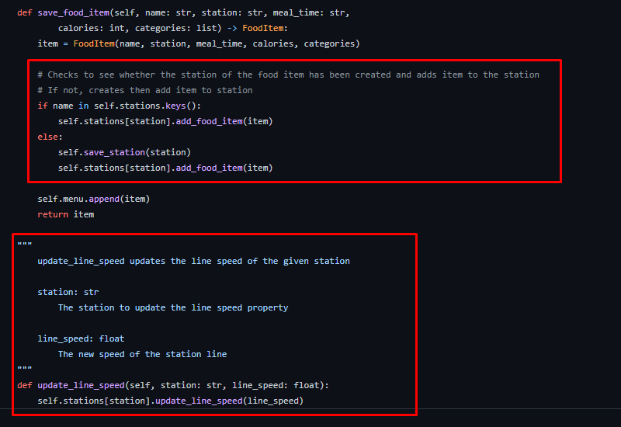
Food Stations Object Continued
Notes:
Ore

Slide 15
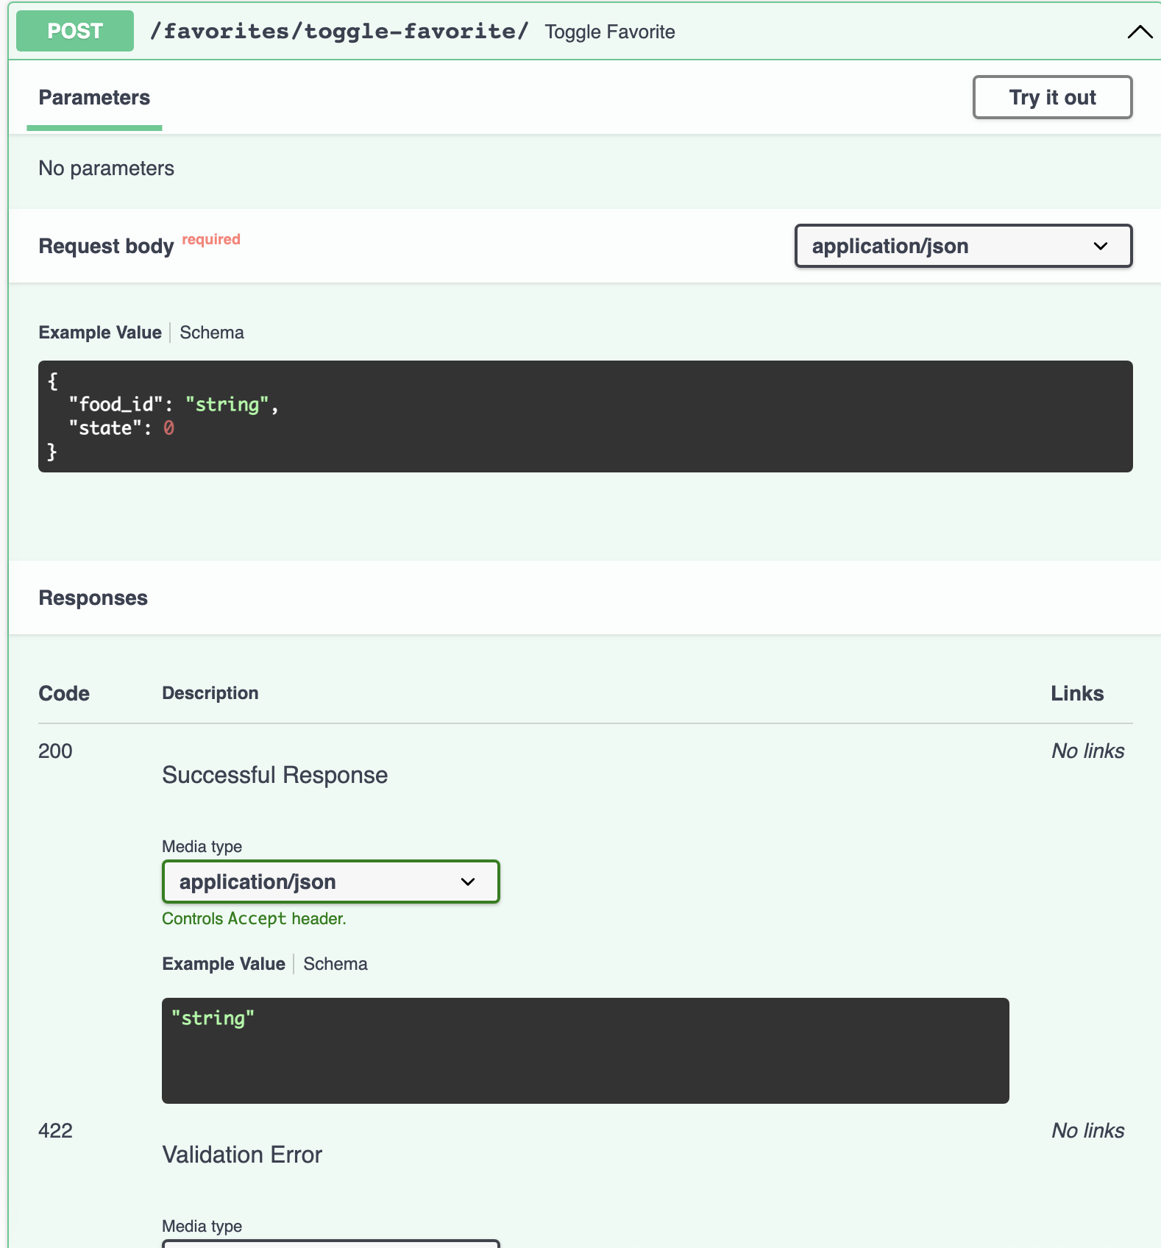
Other Backend Change
Refactoring code to utilize PyDantic
Automatic Data Validation
Easier Database Storage
Notes:
David

Slide 16
Web Scraper Timeline
More Scrapes
Get more data (ex: mealtimes, food-items, stations)
Install
Research
First Scrape
Save to Backend
GitHub, Requests, BeautifulSoup
Base URL, Inspect-Element
Html.parser, soup.find(), print(mealmenu)
Connect to helper methods created by team
Notes:
Miles

Slide 17
Scraper Demo!
Notes:
Miles

Slide 18
03
What are our goals for the week?

Slide 19
1 point
behind schedule!
Notes:
Miles

Slide 20
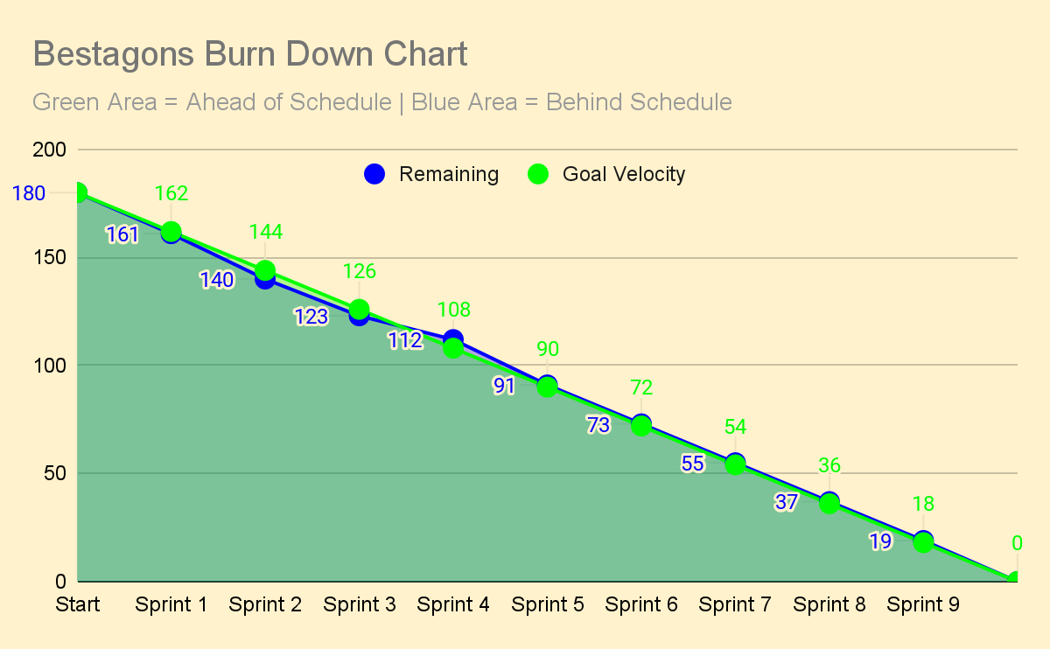
Notes:
Miles
Notes: It was fall break; we will catch up in Sprints 5, 6, & 7.
Webscraper should help us catch up as it is 13 points that is close to done

Slide 21
THANKS
Please remember to share your feedback :)

